Slide 1
L
evel
With
Me
The Isolated Ducks

Slide 2




The Team
Ignacio
Di Paola
Alexander
Gerhards
Lars
Kalthoff
Alexandru
Negoescu
Robert
Pavic

Slide 3
Game development
is a series of
(sometimes radical) metamorphoses.

Slide 4

The Concept
First-person shooter

Slide 5


The Concept
First-person shooter
Same level, different iterations

Slide 6


The Concept
First-person shooter
Same level, different iterations
Developer comments

Slide 7
The Concept
First-person shooter
Same level, different iterations
Developer comments

Slide 8
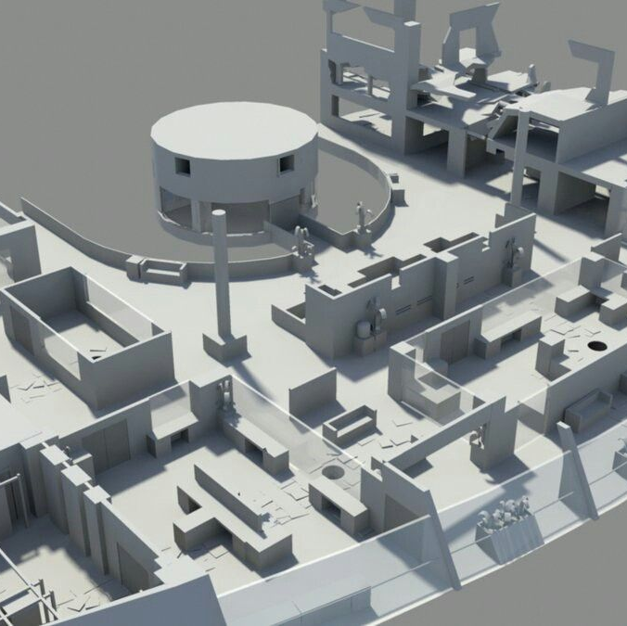
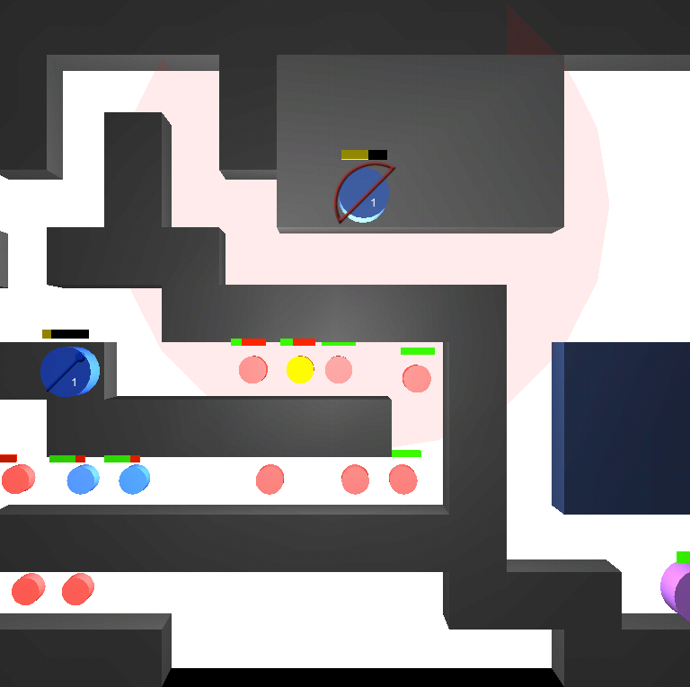
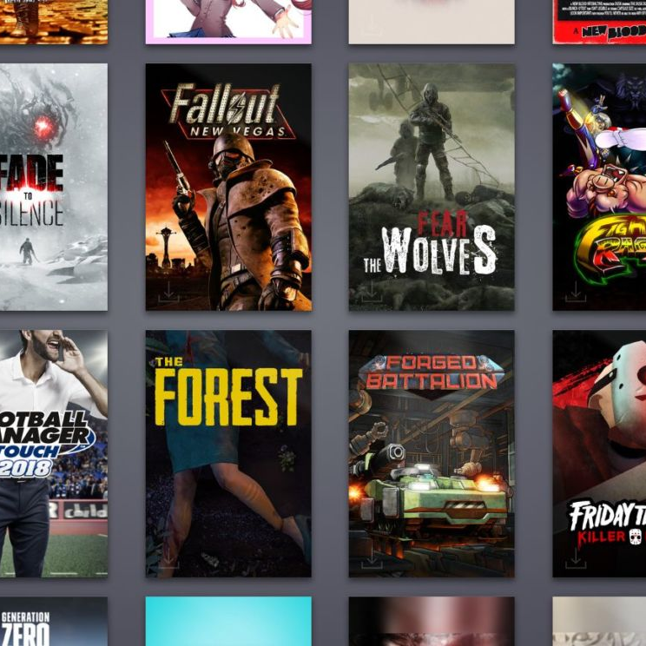
Greybox
level
Abstract
prototype
Release version

Slide 9
Storytelling

Slide 10

Storytelling
1
Transformation of aesthetics, space, and gameplay

Slide 11


Storytelling
1
2
Transformation of aesthetics, space, and gameplay
Fictional developer comments in the level

Slide 12
Storytelling
1
2
Transformation of aesthetics, space, and gameplay
Fictional developer comments in the level

Slide 14
Developer personalities

Slide 15
Developer personalities
Team dynamics

Slide 16
Developer personalities
Workflows & processes
Team dynamics

Slide 17
Developer personalities
Workflows & processes
Team dynamics
Unnoticed
efforts

Slide 18
Developer personalities
Workflows & processes
External
constraints
Team dynamics
Unnoticed
efforts

Slide 19

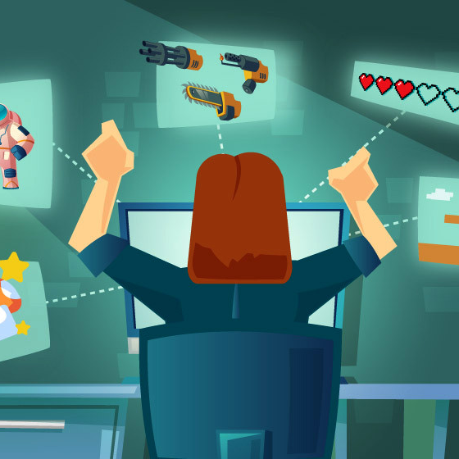
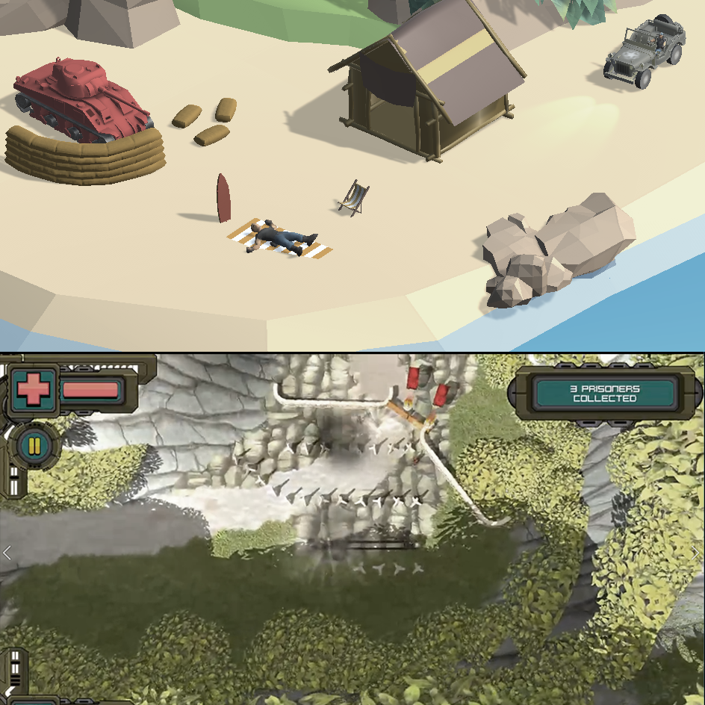
Experimental Aspects
2
1
3
Visualizing a process
Game about
game development
Radical changes in all elements

Slide 20
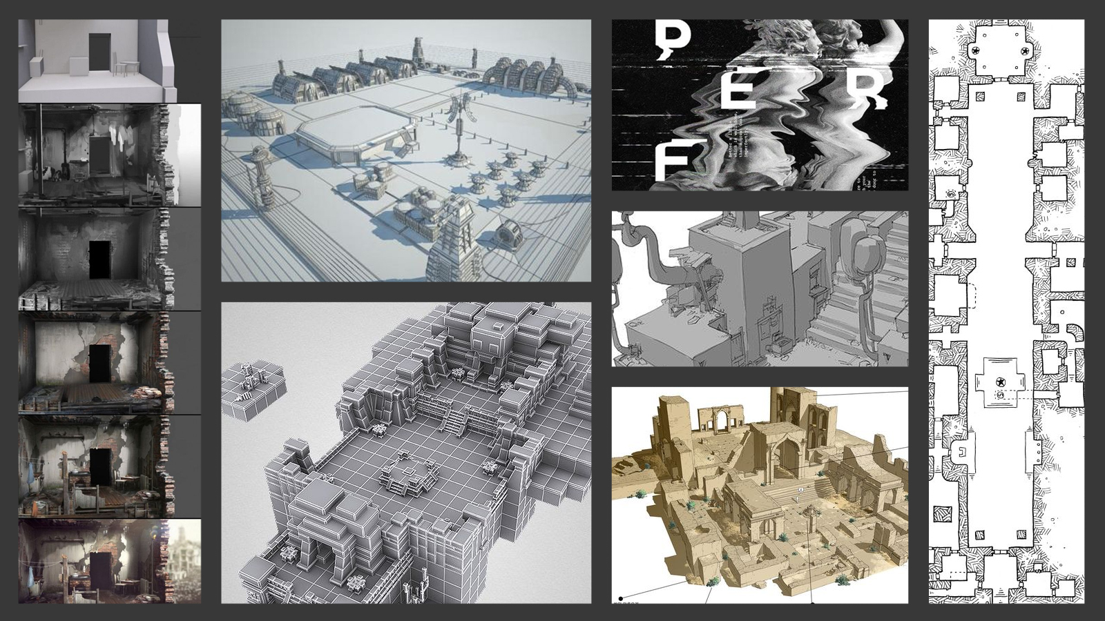

Slide 21


Slide 22
Sound Design

Slide 23

Sound Design
Free libraries for effects

Slide 24

Sound Design
Free libraries for effects
Compose and record music

Slide 25

Sound Design
Free libraries for effects
Compose and record music
Placeholders in early stages

Slide 26
Influences

Slide 27
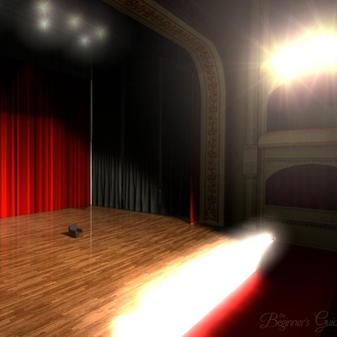
Influences
1
The Beginner’s Guide, 2015

Slide 28
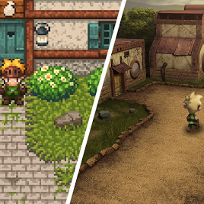
Influences
1
2
The Beginner’s Guide, 2015
Evoland, 2013

Slide 29
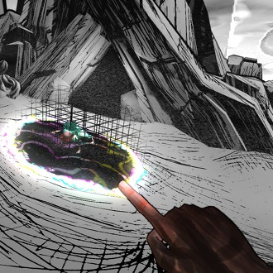
Influences
1
3
2
The Beginner’s Guide, 2015
The Magic Circle, 2015
Evoland, 2013

Slide 30
Influences
1
3
2
The Beginner’s Guide, 2015
The Magic Circle, 2015
Evoland, 2013

Slide 31
Technical Outline

Slide 32

Technical Outline
Unity version 2019.3.8f1

Slide 33

Technical Outline
Unity version 2019.3.8f1
Snapshots of early scripts

Slide 34

Technical Outline
Unity version 2019.3.8f1
Snapshots of early scripts
Bugs are part of the game

Slide 35
Project Management

Slide 36


Project Management
Two project managers,
alternating roles

Slide 37



Project Management
Two project managers,
alternating roles
Agile development,
weekly sprints

Slide 38



Project Management
Two project managers,
alternating roles
Agile development,
weekly sprints
Software
and tools

Slide 39
Project Management
Two project managers,
alternating roles
Agile development,
weekly sprints
Software
and tools

Slide 40
Schedule
MONDAY | TUESDAY | WEDNESDAY | THURSDAY | FRIDAY | SATURDAY | SUNDAY
 |  | 1 | 2 | 3 | 4 | 5
6 | 7 | 8 | 9 | 10 | 11 | 12
13 | 14 | 15 | 16 | 17 | 18 | 19
20 | 21 | 22 | 23 | 24 | 25 | 26
27 | 28 | 29 | 30
Kick-off Presentation
22:00 First Pitch Presentation
R
10:00-16:00 Mandatory
Mentoring
R
R
22:00 Intermediate Presentation
10:00
Watch Presentations
R
External deadlines
Mentoring
Sprints
R
Retrospectives

Slide 41
Thank
You!
The Isolated Ducks

